Slide 1


February 26, 2019
Paper Critique:
Meson: Workflow Orchestration for Netflix Recommendations
Advanced Data Mining and Web Analytics
MSITM, Spring 2018

Slide 2


Meson Vs Mesos
Meson
Trigger
Control Flow
Error Message reporting
Mesos
Resource Allocation
Task Isolation
CPU abstraction

Slide 3
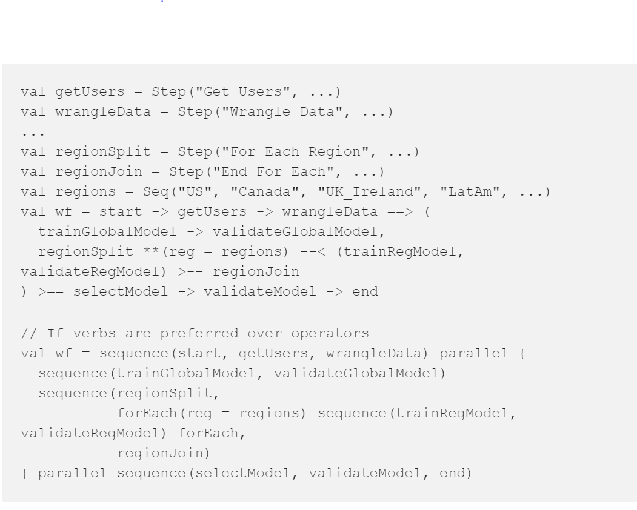
DSL
Glossary of abbreviations should have been mentioned
Comments would have helped in understanding the code
Connection of each line of code with the ML pipeline is missing

Slide 4
Shortcomings
Meson and Mesos interact with each other but its not clear how and when.
Mesos is used for effective resource allocation. Why not use that only for full scheduling?
A demo would have helped in understanding the whole platform and the workflow
Forward Compatibility not addressed properly
One of the primary goals of Meson is to increase the velocity, reliability, and repeatability
The target and whether it was achieved is not clearly mentioned
Factors which define Reliability is not clear

Slide 5
Notable Insights
Enables ML pipeline execution across heterogeneous systems.
Can also be used to schedule tasks other than ML pipelines.
Logs and error messages can be tailored according to user.
Provides native spark support.
Isolation towards particular spark version provides more strength to the developer.
Underlying framework for resource allocation can be chosen to be other than Mesos

